Slide 1
Social Determinants of Health and Composite Indices for Fairfax CommunityScapes
Interim Review
Data Science for the Public Good: Cong Cong, Quinton Neville, Victoria Halewicz, Eliza Tobin
Social and Decision Analytics Division: Teja Pristavec, Josh Goldstein
Sponsors: Fairfax County Health and Human Services, Inova Translational Medicine Institute

Slide 2
Introduction
Goal: Map social determinants of health that influence wellbeing in Fairfax County
Social Determinants of Health: "The conditions in which people are born, grow, work, live, and age, and the wider set of forces and systems shaping the conditions of daily life.” (World Health Organization)
Reasoning:
Health inequities in Fairfax County
Where? Why?
What can be done?
Little information at the subcounty level: only at the county level
Understanding how to adequately allocate resources
Establish a baseline measurement for future policy changes

Slide 3



Process Overview
Select Composite Indices
Set of variables that we cannot observe but that we want to describe
E.g. health, quality of life, happiness
Chosen Indices
Economic vulnerability
Obesogenic environments
Quality
of
Life
Measurable Variables

Slide 4


Literature Review
Examples of Insights
Educational attainment —> reliable socioeconomic status measure
Parental education/income —> children's physical activity
Walkability scores —> elderly fitness

Slide 5



Data Sources
OpenStreetMap

Slide 6

American Community Survey
National survey
5-year estimates at Census block level
Demographic and socioeconomic data

Slide 7
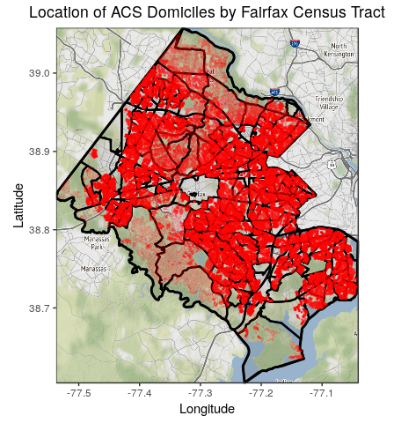
Fairfax Housing Stock Data
Synthetic population generation​
Reaggregated to Census tracts, supervisor districts, and school districts​

Slide 8
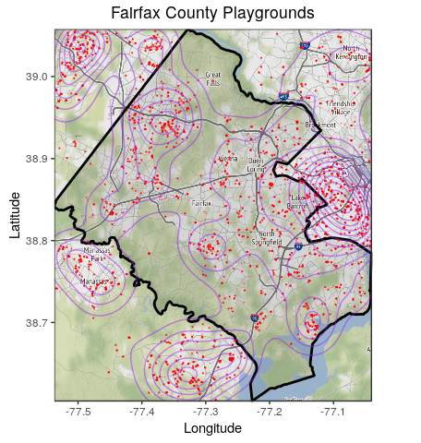
Open Street Maps: Data Discovery

Slide 9
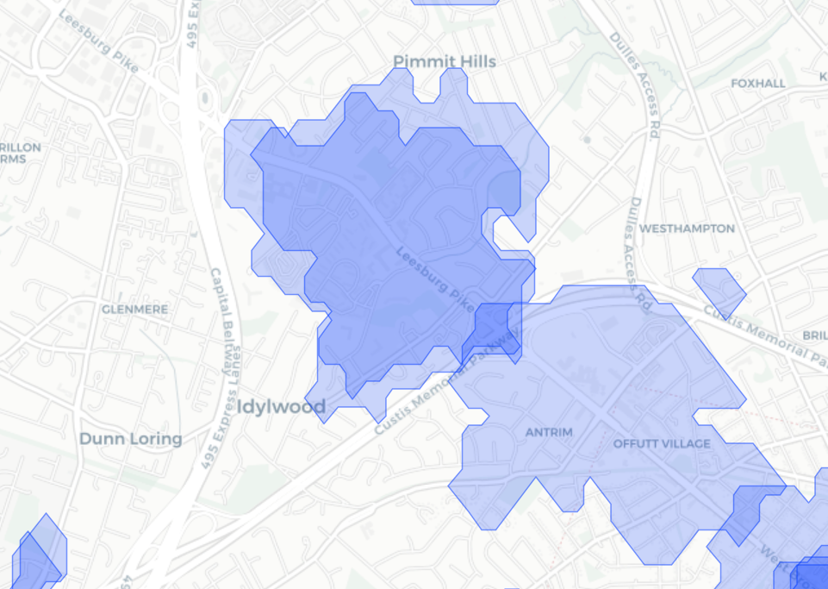
Travel Time Example
20 Minute Travel Area by Bus
Households
Supermarket
http://rpubs.com/ccong2/508061

Slide 10

Index 1: Economic Vulnerability
Income
Education
Age
Race
Ethnicity
Supplemental security income
Public assistance income
English fluency
Poverty
Commute time to work
Example indicators:

Slide 11


Index 2: Obesogenic Environments
Example indicators:
Fast food
Supermarkets
Convenience stores, green grocers
Restaurants
Gas stations
Alcohol stores, bars, pubs
Nature reserves
Parks
Fitness centers
Playgrounds

Slide 12





Looking Ahead
Data
Explore ACS synthetic data
Join multiple sources
ACS, Housing, OSM
Create travel-time distance
SES
https://www.tidyverse.org
Index Construction
Dimensional / Factor analysis
Weighting & aggregation
Interactive visualization
Variables
Food +/-
Obesogenic
Index
Geo

